Slide 4
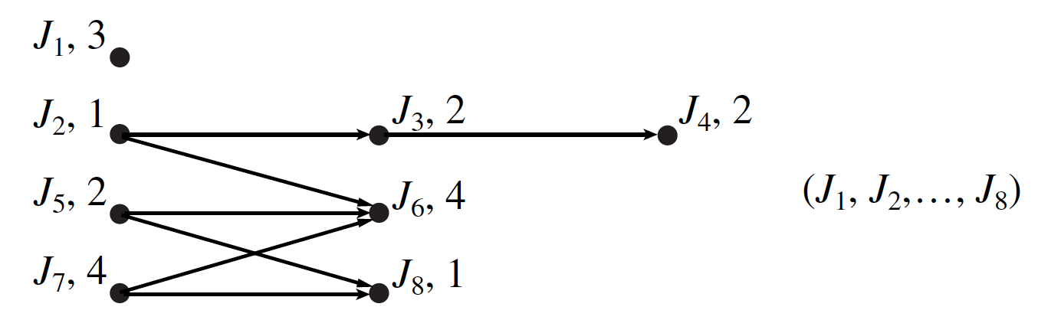

Slide 7
deadline
A
2
B
5
C
4
5
6
D
3
E
F

